Slide 1
Internal Use – Only This Slide
Deloitte Qualifications - Summary
Client | PoCs | Databricks | Advisory | Implement | Support
Japanese Pharmaceutical Client (Takeda Pharmaceuticals) | Lieven Comeyne - Swiss Partner Nishant Sinha - Swiss MD Namrata Kedareshwar – USI SM |  |  |  | 
Health Care Client (HCSC) | Suman Kolla – US MD Simar Gulati – US SM Vamsi Vangala – USI SM |  |  | 
Leading Aluminum Manufacturing Client (Alcoa) | Kevin Gregory – US Principal Sayee Venkat Ramani – US SM Shilpa Dhumal – USI SM |  |  | 
Pharmaceutical and Biotechnology Client |  |  |  | 
American Retail Client (Kroger) |  |  |  | 
Largest Oil field service provider (Halliburton) |  |  |  | 
Large Multi-Agency Federal Client |  |  |  | 
Leading Aluminum Manufacturing Client (Novelis) | Subramanian Karthik – US SM Nirmal Vijay Kumar – USI SM |  |  |  | 
Investment Banking Client (Takeda Business Solutions) |  |  |  | 

Slide 2
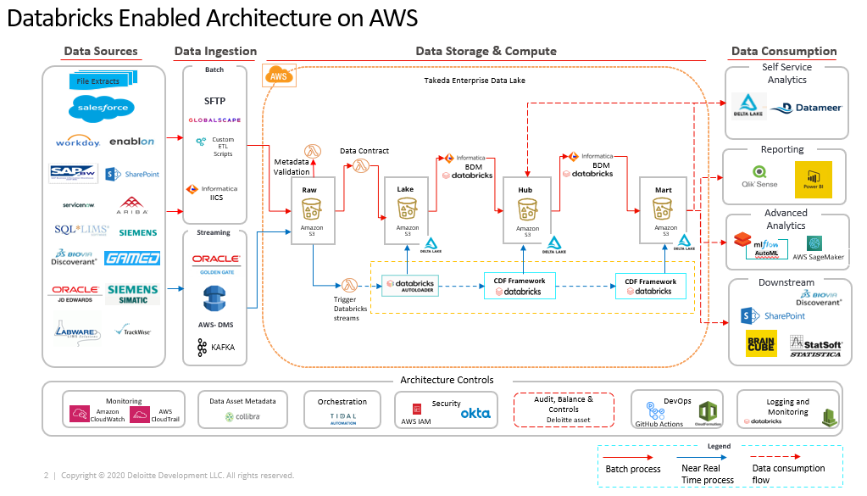
Case Study | Japanese Pharmaceutical Client
TIMELINE
August 2019 - Ongoing
Client is a Large pharmaceutical company, on a cloud modernization journey was looking to migrate assets under management from on-premise to cloud on AWS to facilitate enhanced data processing and cloud storage as the ‘gold source’ for all consumers & downstream systems.
PROBLEM STATEMENT
APPROACH
OUTCOMES & IMPACT
As one of the leading Pharma company, client wanted to setup enterprise data program to accelerate the delivery of digital and analytics use cases by unlocking business opportunities like digital therapeutics, insights as-a service
Vision was to seamlessly integrate with partners across functions like R&D, GMSGQ, Corporate, embed data-driven decision-making and thus, transforming the overall customer experience
Enterprise Data Backbone (EDB) was setup to provide a platform and data capabilities to power global enterprise data ecosystem spanning across R&D, Manufacturing, PDT, etc.
Databricks used as core data and AI platform. Agile was used a project delivery methodology.
Data integration services, storage, visualization and data science capabilities enabled through this integrated platform
Enabled below use cases that facilitates better patient care
Activating Manufacturing Intelligence through integration of data across systems
Implementing Global Quality integration and EHS Analytics by enabling key KPIs
Migration of Global Medical Affairs data from Azure to AWS Marketplace
Addressing critical and regulatory challenges in Plasma Derived Therapy BU
Ability to leverage data practices/tools across the organization and enabled cross-function collaboration through sharing of data models through the EDB platform
Ability to catalog, establish data ownership and ensure data quality throughout the enterprise (including external sources)
Empowered to explore, wrangle and discover data through self-service analyses
ML and Deep Learning models enabled data scientists deliver insights at scale, makes decision science easier
Provided post-production support after the implementation.
Automated data ingestion, transformation and KPI calculation leveraging delta live tables of Databricks within client’s new AWS platform – Enterprise Data Backbone (EDB) , to help remove the issues w.r.t siloed data and human centric processes
Streaming framework using micro batching for ingestion and processing to achieve data availability in near real time mode
Batch processing framework using Informatica IICS, and BDM has been setup with the push down compute to Databricks
Leveraged change data capture with merge and change data feed and setup Audit Balance Control framework on the delta lake platform
Enabled the platform with single source of truth and standardized, contextual layer storing dimensional data model for cross-functional KPIs/analytical use cases

Slide 3
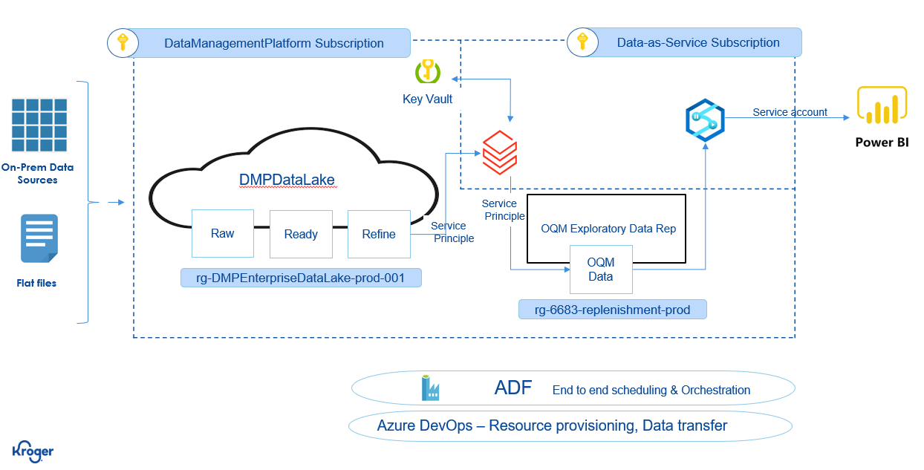
Case Study | American Retail Client
TIMELINE
Client is a large retail company that was looking to modernize its order quality metrics platform to gain faster insight on “behavior” patterns to improve inventory management.
PROBLEM STATEMENT
APPROACH
OUTCOMES & IMPACT
The Order Quality Metric tool is a is a Power BI diagnostic dashboard and databricks logic helps client to get updated data to gain faster insight on “behavior” patterns to improve inventory management.
Use Databricks to process 2300+ stores data weekly on Monday along with prior 4 weeks that gives ability to evaluate the quality of the initial SUGO prior to any adjustment activity and the final order quantity.
It is used to evaluate the quality of either the overall SUGO or compare adjustment quality of the LBOH compared to what the SUGO quality would have been before the change.
Databricks used as core OQM platform to process the stores data and deliver it for consumption. ADLS Gen2 is used for Storage.
From sources, refined divisions[ each divisions has multiple stores tagged] data is pulled and processed via databricks.
A notebook takes care of the updated list of divisions, stores and commodities that are required for reporting.
A reusable notebook for each divisions and it's wrapped inside a wrapper notebook where parallel execution is enabled.
Cluster is configured to run 8 notebooks in parallel.
A notebook to merge last 4-week data that basically store in storage account and use as external table in synapse.
ADF is used for orchestration.
All 2300 stores data has been onboarded and made available for operation reporting.
Capability to gain faster insight on “behavior” patterns to improve inventory management.
A notebook takes care of the updated list of divisions, stores and commodities that are required for reporting.
A reusable notebook for each divisions and it's wrapped inside a wrapper notebook where parallel execution is enabled.
Cluster is configured to run 8 notebooks in parallel.
A notebook to merge last 4-week data that basically store in storage account and use as external table in synapse.
Optimized execution of notebooks with 8 parallel threads enabled in cluster. Now we are running 8 parallel data process notebooks at a time that means 8 divisions process are running at a time and improved the performance by 3 times.
Created separate pool cluster with 30 nodes to remediate memory issues during parallel execution.

Slide 4
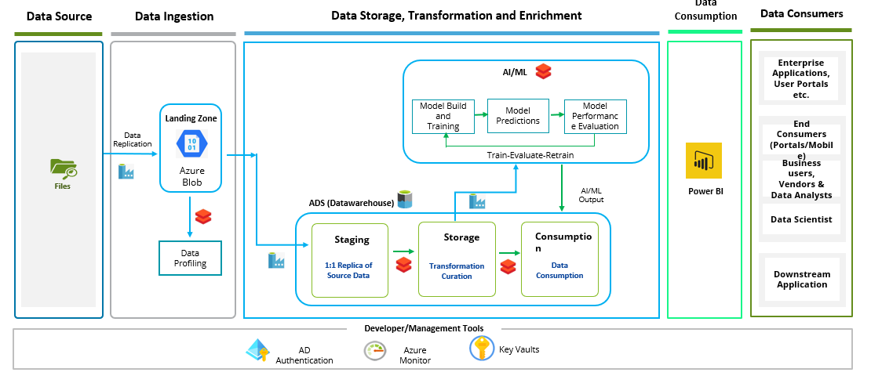
Case Study | Largest Oil field service provider
TIMELINE
Client is a Large oil field service provider company, that embarked on a journey to strengthen its data and AI capabilities to accurately predict and forecast disputes and cashflow thereby improving customer relationship and better decision making.
PROBLEM STATEMENT
APPROACH
OUTCOMES & IMPACT
The organization's invoice processing cycle is often prolonged due to a variety of dispute scenarios, redundant errors, extensive manual intervention, and validation occurring at later stages of the invoice closure process, resulting in significant payment delays
Lack of clarity and control over the invoice dispute probability resulting in a backlog of outstanding receivables
Organization spend countless hours calculating the components of a cashflow forecast, aligning the components and consolidating the results
The team struggles with consistency of accuracy, analysis of variations from actual and identifying anomalies in future forecasts.
Prediction: Developed a series of AI/ML models in a Model Tree approach to solutioning. The models addressed individual forecasting components including A/R, A/P, Inventory and Net Income forecasting.
Incorporated an ML-process to continuously evaluate drivers for variation and drift to improve/ maintain forecasting accuracy over time.
Developed a series of AI/ML classification models for dispute prediction based on historical trend with detailed feature contributing score.
Visualization: Built a single Forecasting dashboard to provide transparency into results, drivers, driver correlations, and best-fit model; enabled scenario modeling capabilities in system and the ability to capture analyst notes and provide AI generated messaging of results.
Built a single dashboard to provide transparency into results, feature drivers contributing to the dispute, and best-fit model with high accuracy.
Increased global forecasting accuracy to 98-99%, over the short and mid-term forecasts.
Reduced forecast execution effort by 90% through ML-enabled driver testing and training
Reduced forecast delivery timeline by 98% new forecast is available in hours vs days in previous approach
Improved FP&A user experience through single point of interface, detailed explanation of variances, increased model transparency and use of NLP/NLG to support analyst interaction
A centralized data assets with improved data quality, find ability, and insights derived from data and information.
Accurate invoice dispute predictions( 80-85%), for large scale customer invoices. Enhanced customer relationships: Anticipation of potential errors/discrepancies helped to avoid disputes and improve customer relationships
Increased business process efficiency: Automated processing of invoices with low dispute probability to reduce manual intervention and administrative costs. Streamlined the invoice processing cycle by taking necessary steps in advance to mitigate the risk of disputed invoices
Improved cash flow & decision making: Enabled informed decisions about pricing, payment terms, and other factors that affect invoice processing and reduced the risk of cash flow problems
Designed enterprise data and analytics Center of Excellence (CoE) including governance, architecture, technical
delivery capability and clear business understanding to deliver Analytics capabilities for business use cases.
Provided operational models, standards, processes and policies needed to maintain authority, control and
protection of data assets and delivered use case backlog, metrics catalog and playbook.
Designed processes to migrate source data into target system of the client and performed data profiling, loaded the cleansed data into Azure Databricks.
Created a robust framework for data analytics and performed various data transformation as per the
consumption data models using Azure integration tools.
Developed data models for Al use cases and showcased the end-to-end process to manage and measure delivery of data and analytics to the business.
Built time series-based machine learning solution using LSTM,N-BEATS & SVR forecast models to derive accurate long-term predictions, eliminate manual errors and enabled data-driven decision making to catalyze growth using analytics capabilities.
Developed a series of Al/ML classification models using MLP and Neural Network algorithms for dispute
prediction based on historical trend with detailed feature contributing score.
Designed insights and visualization using Power BI to drive faster decision making & optimize financial operations by fostering best-fit Al model insights with high accuracy.

Slide 5
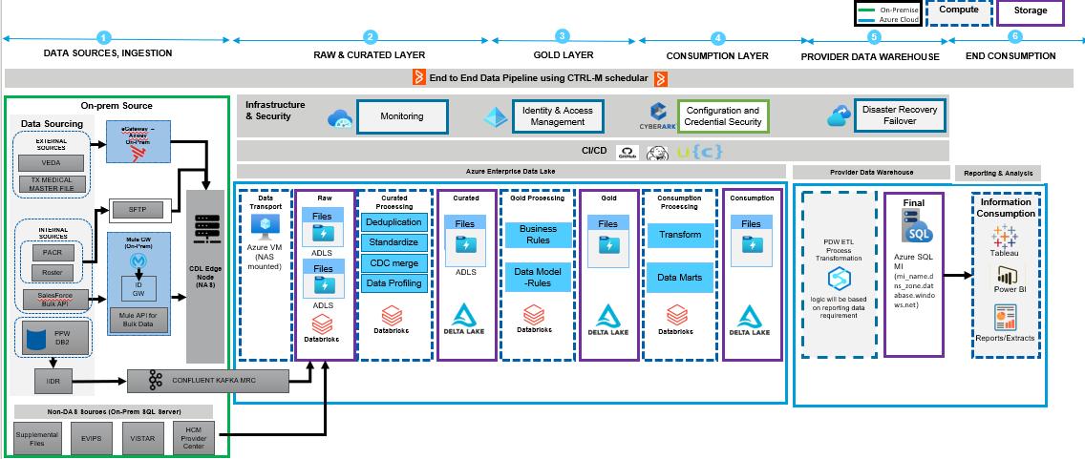
Case Study | Health Care Client
TIMELINE
2022 – Ongoing
Client is a Large health care insurance company, is undergoing a transformation of its enterprise data assets, resulting in the replacement of Hadoop based Commercial Data Lake (CDL) with Microsoft Azure Databricks Delta Lake based platform
PROBLEM STATEMENT
APPROACH
OUTCOMES & IMPACT
The objective of this initiative is to complete the migration of all workloads, extracts, and consumption from Hadoop CDL to Azure Databricks Delta Lake. A high-level analysis of all workloads on CDL is completed and a roadmap for migration of 22 products has been established by Services Vendor and approved by HCSC DAP team. The scope of Services consists of process conversion, using Data Switch (“DS”) utilities required for migration.
Data from all different sources (internal/external) will be routed to Azure storage ADLS Gen2 Raw layer. Databricks will be utilized for ingestion to raw layer.
Raw layer data is validated first for mandatory fields and data level issues. Validated data is then curated and placed on Curated Zone.
Data is picked from Curated zone for transformations to generate the final snapshot of data. The finalized data set is stored on the Gold layer.
Gold layer data is being utilized by different consumption teams to leverage the data elements obtained after transformations and stored in final Consumption layer in ADLS.
Data from Consumption later is Processed as per reporting requirements and finally stored into Azure SQL MI. PDW data will be consumed by various BI tools and analytics extract as well as Data Bridge .
Multiple products has been successfully onboarded to Databricks from Hadoop Platform.
Use of Conversion tools and automation tools for testing has helped faster onboarding of products.
Automated data ingestion, transformation and delta live tables of Databricks within client’s Azure platform
Automated data validation using CATE.
Dataswitch is used as the conversion tool to convert Hive scripts to Databricks SQL scripts/Pyspark scripts.

Slide 6
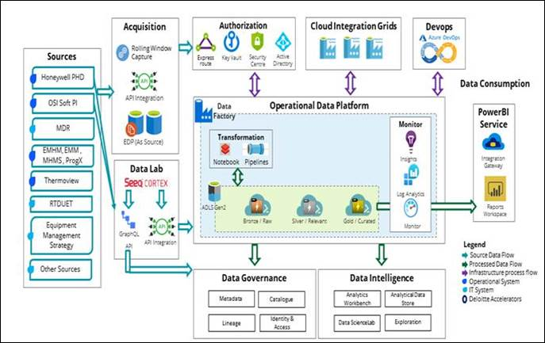
TIMELINE
Case Study | Leading Aluminum Manufacturer
July 2021- Ongoing
The client is a global industry leader in bauxite, alumina, and aluminum products with direct and indirect ownership of 28 operating locations across nine countries. Deloitte has partnered with Client to enable an Operator Centric Future state where data is treated as an asset and can deliver material uplift in the company’s performance.
PROBLEM STATEMENT
APPROACH
OUTCOMES & IMPACT
Alumina and Aluminum are subjected to significant volatility and therefore influence the operating results of the company. Hence the client has made the strategic decision to enable an operator centric future state where data is treated as an asset and supported by a culture that protects and uplifts its quality.
Challenges:
Lack of a unified data platform that can ingest and integrate OT & IT data from various source systems.
Inconsistent usage of attributes and definitions that caused a disconnect between production and maintenance data.
Data integration from SEEQ third party vendor data with the target state. Absence od self-service requiring the users contact internal support teams.
Defined an enterprise-wide flexible data model that ingests data from multiple sources using metadata driven ingestion pattern and provide a low latency ingestion architecture.
Implemented a consolidated operation data platform on Databricks with single data lake [Bronze, Silver, Gold] storage. Established E2E traceability from source to target.
The link between production data and maintenance products was made by linking asset numbers and its hierarchies across different sources. This in turn gave results based on actual maintenance and production costs, assets availability and parts that needed to keep maintenance of products in check.
Implemented role-based security in databricks file storage.
Developed a robust self-service module to enable user specific time slice patterns for IOT signals.
Implemented Azure Devops for continues code deployments.
Established connectivity with Edge sites and provided low latency ingestion architecture with synchronizing, profiling, and sampling of metadata.
Utilized Collibra relation concepts to deliver lineage between the 3 layers.
Enabled the business to make the right decisions at the right time based on the insights from operations Data platform.
Scalable and Reusable IOT ingestion framework based on databricks.
Robust self-service module for user specific time slice pattern for IOT signals.
Successfully ingested & onboarded 300+ tables across sources into the platform.
Implemented business glossary with 50+ business terms which has multiple language capabilities.
Over 20 policies were implemented in the Data Governance solution.
Metadata driven framework to ingest multiple datasets in Parallel. Payloads for Jsons are flattened by the framework before ingestion.
Reads the API endpoints from Web Application , parses JSON responses and normalizes datasets at 2 levels while ingesting into the Landing Layer
A framework to automate generation of Merge statements for Persistent Layer loading
A framework to generalize loading of Type 1 and Type 2 Dimensions
Identify newly appearing flat files, audit and load these files using incremental discovery functions
Data Validation methods:
Industry standards:
Python script to automate testing
Automated Data Quality framework
Databricks Pyspark integrated with Azure Data Factory
ABC framework across all 3 layers.
DQ rules are dynamically implemented using Spark java custom code and metadata driven framework

Slide 7
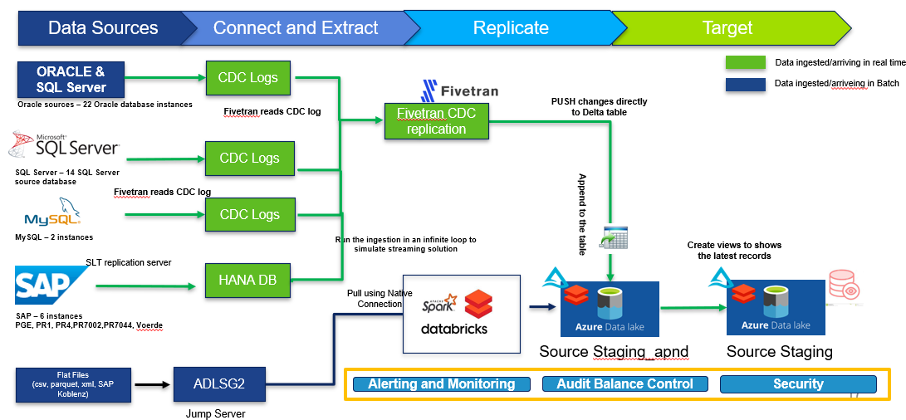
TIMELINE
Case Study | Leading Aluminum Manufacturer
July 2021- Ongoing
The client is a large Aluminum manufacturer, who needs a consistent, comprehensive Data Ingestion Framework for real time Data Streaming to get real time insights for operational reporting.
PROBLEM STATEMENT
APPROACH
OUTCOMES & IMPACT
There is a need for the client to have a consistent, comprehensive Data Ingestion Framework for real time Data Streaming to ensure the lowest possible data latency with the highest possible quality and utility of data for all downstream use cases.
Started with conducting a POC to identify the best CDC tool that caters to multiple source systems such as SAP/Oracle/MySQL/File based sources for streaming data ingestion.
Our strategy and proposed design will ensure that there is no/minimal impact to downstream application.
Data will be loaded to Azure Databricks [ ADLS Gen2] raw layer then to the subsequent staging and enterprise layers.
A new database will be created in Databricks. Fivetran will directly write to this database. Table names will be like source staging database except that they will be suffix with _apnd or _working.
Existing source staging tables will be recreated as views which will have logic to pick up the latest records.
End users/downstream will not notice any difference in their data access.
Real time data availability from source systems to consumption programs like Demand planning (O9) and Plant of the future(POTF) which will help the Client with real time view into the state of things such as Inventory, Purchase orders and Planning.
FIVETRAN streams CDC transactions in real time and loads them directly into Delta tables [ FIVETRAN has native connectivity with Databricks].
Table names will be like source staging database except that they will be suffixed as per standards.
Existing source staging tables will be recreated as views which will have logic to pick up the latest records.
No extra hop or layer. Data gets inserted directly into the Delta table from source without need Databricks compute resources.
Data Validation methods:
Industry standards:
Python script to automate testing
Automated Data Quality framework
DQ rules are dynamically implemented using Spark java custom code and metadata driven framework

Slide 8
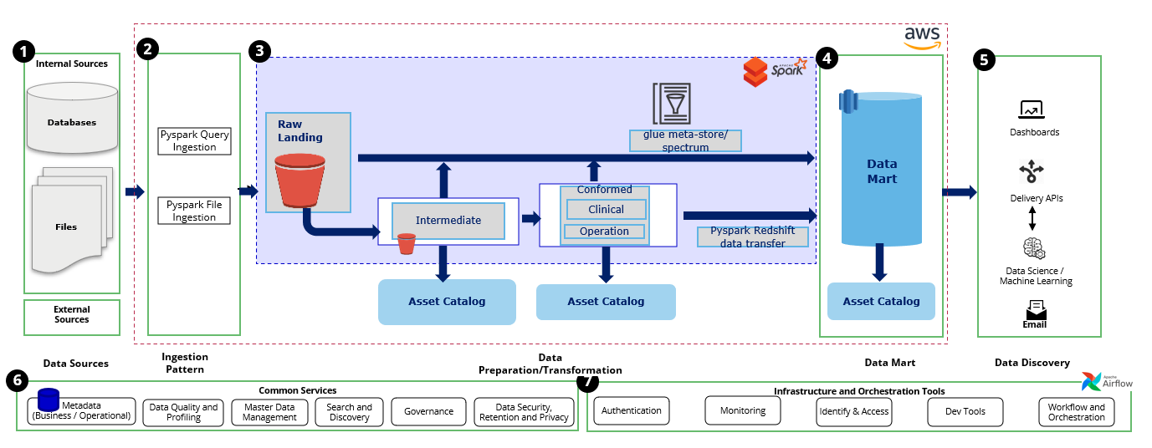
Case Study | Pharmaceutical and Biotechnology Client
TIMELINE
June 2021 - Ongoing
Client on a cloud modernization journey to re-platform the Map R environment to Databricks decided to migrate Talend ETL code, custom scripts to overcome the challenges and limitation of the Map R platform.
PROBLEM STATEMENT
APPROACH
OUTCOMES & IMPACT
US based Pharma client’s Map R on AWS platform lacked the scalability necessary to meet the growing data and AI/ML needs of the business.
Client decided to modernize Map R environment to Databricks and Talend ETL code to custom scripts to overcome the present challenges and limitation of the current platform
Developed platform reference architecture oriented to a federated Data Lake, including capabilities and components across the life-cycle. Used Agile methodology as a project management approach.
ADLF (Augmented Data Lake Framework) was leveraged to accelerate setup of data lake on Databricks.
Analyzed current Map R based architecture and created target Databricks architecture and documented the approach for migrating data pipelines
Analyzed existing Orchestration Framework and data pipelines & Built a phased migration plan for inventory of pipelines to be migrated for all identified scenarios
Identified a data pipeline to use for reference implementation & built , documented reference implementation
Migrated the Map R Workloads to Databricks on AWS
Designed and built historical migration patterns
By using Databricks parallel processes and New Job Clusters, optimized run time from 12 to 4 hours
Able to automatically run all jobs without manual monitoring of available CPU and Memory resources
Created the environment, which allows to add additional processes without affecting existing one.
Converted 2,000+ tasks to Databricks jobs for 4 Data Marts
Converted 1000+ Redshift Tables & 20,000+ Redshift Spectrum Tables
The client realized 60% reduction in the TCO over a 3-year period, while seeing a performance improvement of 5x in their end-end Data and AI capabilities.
Reference Architecture
Three phased approach has been defined to migrate the platform, orchestration framework and Datamart’s.
The Talend TAC orchestration was retrofit into airflow DAG’s and all the functionalities of Talend template jobs were replaced to notebooks in Databricks.
Custom code was enabled for all Talend Job Categorization – Talend jobs are categorized into three groups and all them are categorized in Custom scripts in Databricks Notebooks. Individual components are converted to custom code
Delta Lake provides snapshots of data enabling developers to access and revert to earlier versions of data for audits, rollbacks or to reproduce experiments.
DATA VALIDATION METHODS
.
Ability to execute the jobs in Databricks environments.
Retrofit Talend DAG and Talend jobs
Defined the job migration with change log details and configuration updates

Slide 9


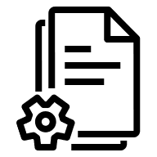
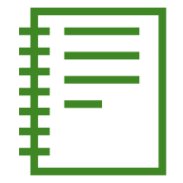

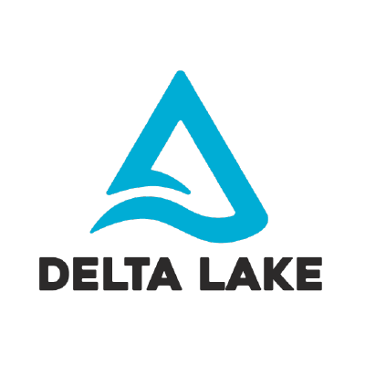
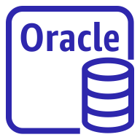
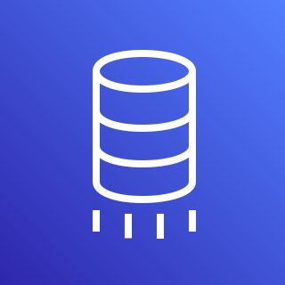

Case Study | Large Multi-Agency Federal Client
TIMELINE
August 2019 - Ongoing
The client is a large federal entity who was facing a need to unify their disparate, multi-agency data to provide a single place to gather mission critical insights across the federal agency space.
PROBLEM STATEMENT
APPROACH
OUTCOMES & IMPACT
Disparate and continuously growing data sources with a need for federation of data to enable cross-agency data sharing and coordination
Lack of visibility across key client entities (people, organizations, companies), because the relevant data about each entity resides in disparate systems
Reliance on manual processes to resolve entities across siloed systems, and establish relationships among entities, which delays delivery of client's mission critical data
Delayed and outdated data reflected in systems due to siloed repositories that update on a batch schedule
Current data governance solution requires custom code, excel spreadsheets and explicit confirmation from stakeholders for changes
Utilize Databricks to perform large scale near-real time replication of enterprise level databases into a single Data Lakehouse at scale and at speed
Leverage AWS services such as S3 and Data Migration Service which allow Databricks to host multiple terabyte databases in a single data lake
Transform various disparate data types into a modem relational structure using Databricks Delta Lake to keep up with industry standard ACID database practices
Enforce Data Governance standards across platform with a standard policy using Immuta to provide a single platform to manage access across use cases and agencies
Ingest data and build out data transformation pipelines using Apache Spark to leverage Databrick’s scalability and enable parallelization and performance
Combine big data repositories with the benefits of fast data access with a distributed graph database application and combined with an intuitive, custom built user interface to address client needs
Leverage Deloitte’s data engineering subject matter experts to employ entity resolution algorithms to determine a probabilistic match between entities from disparate data sources, within the graph database
Provided client with the ability to specifically identify and match entities across agencies to improve efficiency across the mission and discovery process
Enabled client to quickly identify entity relationships and provide insight to data investigations through graph analytics that were not possible prior
Enhanced client's ability to rapidly perform historical analysis, reducing analysis time from days to minutes
Allowed senior level leadership to make key operational decisions based on daily reports reliant on data that lives in the Deloitte solution and Databricks Delta Lake
Improved the ability for clients to receive and share data by delivering custom service applications with response times under 10 milliseconds
Provided client flexibility to shift resources to address evolving mission priorities by implementing an agile development process that improves the speed at which changes are delivered to client
Allowed clients to use Databricks Data Lakehouse as a self-service application for their data engineering needs transforming solution into a Data Mesh
REFERENCE ARCHITECTURE
AWS DMS streams CDC transactions in real time and loads them into S3 with a folder dedicated to each table
CDC data tracks the transaction type and the time of the record being processed
Databricks Autoloader listens for new S3 files and processes them into Delta Lake as a streaming job
One Autoloader job is dedicated for each database and can be scaled up as necessary
Custom Databricks code updates, inserts, or deletes target Delta Lake table based on transactions from S3
DATA VALIDATION METHODS
Source
S3
Databricks
3
Notebook
AWS DMS
Autoloader
Database
Database
5
t1
4
t1
1
2
Row Count:
Check if the number of records per table in Databricks ma tches exactly with the number of records in the source (Oracle, PostGres, etc)
Industry standards:
Variety of tools compatible with Databricks that evaluate data as it is ingested, based on rules. Ex: make specific columns only have certain values or a column only contains numbers and no blanks. These tools are made to run against Databricks data and return results on the quality of that data for viewing later.
t2
t2
t3
t3

Slide 10
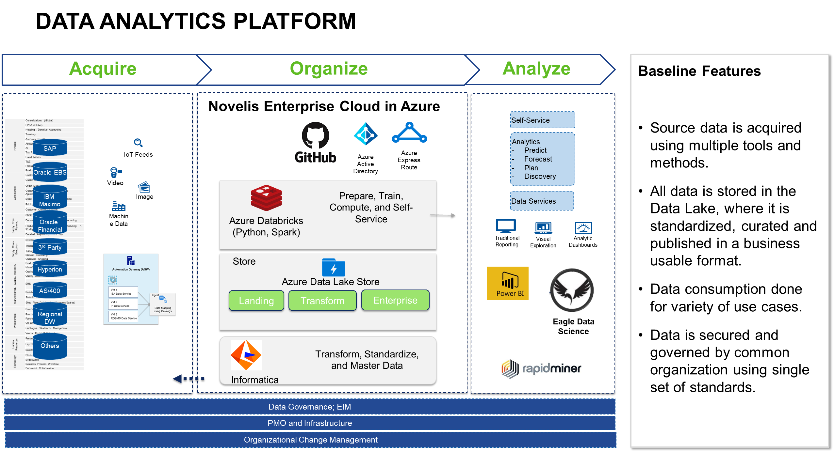
Case Study | Leading Aluminum Manufacturer
TIMELINE
July 2018- Ongoing
The client is a large Aluminum manufacturer , faced with significant roadblocks in meeting their rapidly growing data needs caused by legacy architecture implemented on Azure HDInsight.
PROBLEM STATEMENT
APPROACH
OUTCOMES & IMPACT
The client wanted to upgrade there existing data analytics platform from by migrating –
Informatica BDM 10.2.1 from Informatica DEI 10.4.1
Compute from HDInsight to Databricks (Hive to Delta Lake)
Storage from ADLS Gen 1 to ADLS Gen 2
Issue with existing architecture –
Issues with incremental data ingestion to data lake – could not meet daily data load SLA
Very slow compaction process using UNIX to perform upserts in hive table leading to missed business SLAs
Slow query performance/report refreshes leading to poor user experience
Started with conducting a POC to understand the clients existing ecosystem and assess the existing jobs’ compatibility with the new/target architecture
Institutionalized agile team structure to have SME’s from client’s team, as an integral part of the team
Spawned a new POC environment with the target state and migrate around 40 jobs (a wide variety of jobs including ingestion jobs, data processing jobs
Found around 10 compatibility issues and designed workarounds to address them – also worked with Informatica and Databricks alliance to build and implement EBFs for multiple compatibility issues
Updated 2000+ informatica jobs (mappings/workflows/applications) to be compatible with DEI 10.4.1 and moved processing to Delta lake
Able to achieve daily data load for all ERP systems to meet all business SLAs (even added multiple data loads for system)
Better performance with informatica pushdown to databricks environment
Databricks Integrated platform to ingest, process and query batch and real-time/machine data
Delta tables provided flexibility of upsert, faster query responses, time travel etc. leading to better user experience/faster data analysis and reporting
On-demand compute (controlled cluster-up time) based on usage leading to lesser infrastructure cost
Providing 18*5 SLA based services, with on-call support for rest of the hours and weekends.
Holdings data is ingested via ETL batch / near real time / real time process with built-in validation to produce standardized data structure output built on AWS Data lake ( S3)
DATA VALIDATION METHODS
Industry standards:
Python script to automate testing
Automated Data Quality framework
PySpark based ingestion framework
File validation checks are performed in the first layer of S3 and enables early error detection
DQ rules are dynamically implemented using Spark java custom code and metadata driven framework

Slide 11
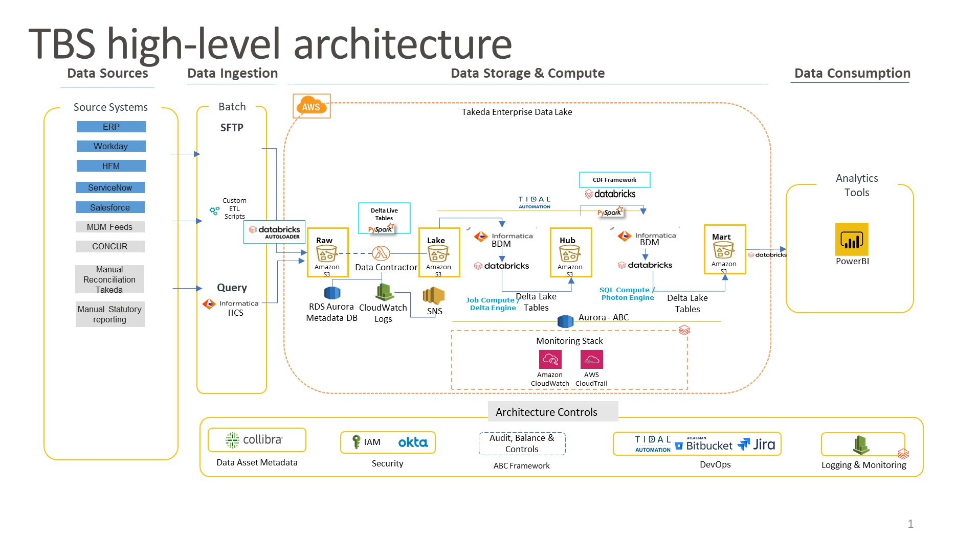
Case Study | Investment Banking Client
TIMELINE
March 2022 - Ongoing
Client is a Large investment bank in the US looking to migrate assets under management from cloud era to AWS Databricks to facilitate enhanced data processing and cloud storage as the ‘gold source’ for all consumers & downstream systems.
PROBLEM STATEMENT
APPROACH
OUTCOMES & IMPACT
Client’s team has built an inhouse Spark-based ETL framework(DLP) to enable multiple LOB for data ingestion, transformation and advance analytics.
Current data ecosystems on Hadoop houses several Petabytes of data which is consumed by downstream users using different tools
In current ecosystem, size and scale of the data has led to high latency to consume data due to load failures and resource constraints, and considerable overhead to maintain and refresh the ecosystem
Migrate/modernize the legacy applications built on Cloudera, Informatica, Abnitio into Databricks
Leverage Databricks processing on EMR to process large databases
The data is hosted on AWS S3 and Databricks to host multiple petabytes of data in a single data lake
Transform various disparate data types into a modem relational structure using Databricks Delta Lake to keep up with industry standard ACID database practices
Ingest data and build out data transformation pipelines using Apache Spark to leverage Databrick’s scalability and enable parallelization and performance
Combine big data repositories with the benefits of fast data access with a distributed graph database application and combined with an intuitive, custom built user interface to address client needs
Client is provided with clear improvement on the performance stats compared to the legacy architecture vs data bricks implementation
Established the performance improvement (Enrichments, Reads, and Merge) achieved by using Databricks
30-50X performance improvement; Further optimization using Databricks’ Z-ordering feature
Improvement in developer productivity by reducing overheads due to unavailability and troubleshooting effort
Able to process peta bytes of datasets with optimal performance and the whole eco system refresh cycle time is reduced drastically
Established Databricks advanced capabilities such as DLP pipeline, Delta, ephemeral clusters and Z-Order Optimization
Cloudera workloads are migrated to Databricks
Metadata driven framework to ingest multiple datasets in Parallel. Paylods for Jsons are flattened by the framework before ingestion
Deployed the Hive Meta store and data model after conversion on Delta lake
Metadata driven framework to create delta live tables for seamless real time and batch ingestions
Data is merged to target tables using metadata driven Merge statements with Tables, frequency etc
DATA VALIDATION METHODS
Row Count:
Data cloud Analytics Test Engine is leveraged to check if the number of records per table in Databricks matches exactly with the number of records in the source (Oracle, Postgres, etc)
Industry standards:
Variety of tools compatible with Databricks that evaluate data as it is ingested, based on rules. Ex: make specific columns only have certain values or a column only contains numbers and no blanks. These tools are made to run against Databricks data and return results on the quality of that data for viewing later.

Slide 12
Internal Use – TBU
Case Study | Health Insurance provider Client
TIMELINE
Client is a large health insurance company that was looking to create a centralized Azure Data Hub to enable Reporting and Advanced Analytics capabilities.
PROBLEM STATEMENT
APPROACH
OUTCOMES & IMPACT
The client engaged Deloitte to develop a single source of truth to visibly gain insights into the drivers of overall medical cost PMPM and enabling users to focus attention of engaging with specific members that may be driving cost due to high utilization or unit cost of a specific service. Across all key metrics, gauge practice performance against benchmark values for PMPM, utilization, unit cost, and average length of stay.
Created schema free ingestion process to ensure fast data ingestion from different sources and formats.
Create Azure cloud based highly scalable and elastic architecture to ingest and process the data from various sources.
Unified model to support analytics
Consolidated data from On-Prem OLTP systems to cloud.
Delivered per member cost per month for users to address problem areas to decrease the overall spend.
Ingesting most granular data at each claims and diagnosis level and providing further insight into areas that can seek improvement.
Unified data model to ingest claims from various claim processing systems
Configuration driven automated pipeline to ingest the data
Visualization to provides insights on PMPM for various combinations
Drilldown capability to identify member / claim level to understand who is driving the high PMPM
Calendar level comparisons for PMPM YoY, QoQ etc.

Slide 13
Internal Use – TBU
Case Study | Largest Food and Beverage Client
TIMELINE
Client is a large Food and Beverage company.Deloitte and Nestlé collaborated on a modernization program to develop and maintain a data lake in the cloud, tearing down siloes and providing reusable data assets that can be used by all business functions
PROBLEM STATEMENT
APPROACH
OUTCOMES & IMPACT
The client multiple on-premises and siloed systems to store and manage its data. These unintegrated systems and all business functions operated in siloes, which led to multiple versions of duplicate data and non-standard key performance indicators and measures for reporting.
The arrangement hampered collaboration between business functions and created an environment for multiple “versions of the truth.” Plus, Nestlé found it difficult to build an advanced analytical engine or unified reporting because of the additional effort needed to constantly aggregate data from the siloed systems.
Deloitte worked with Nestlé to define their data and platform modernization vision, strategy, and roadmap.
Deloitte delivered data lake solutions using an agile methodology and a phased implementation approach and delivered a well-managed, scalable data lake.
Identified and prioritized artificial intelligence/machine learning (AI/ML) use cases, then conducted a pilot for a couple of use cases in a few lead markets, which were later scaled and deployed to markets nationally and globally.
User-persona-centered design guided the solution development during the data lake program.
Deloitte helped build continuous integration/continuous development (CI/CD), DevSecOps, and MLOps processes. Combined with Deloitte’s cloud accelerators, Nestlé has significantly reduced its time to production and gained efficiency in development efforts
Successfully transitioned 800+ sales representatives to use the SRE app for prioritizing store visits based on recommendations from the engine built by Deloitte. Nestlé drove 3% additional sales in their major customers through the SRE.
Successfully integrated structured , semi-structured and unstructured data from 10+ sources into data lake to drive SKU assortment performance by analyzing changes in pricing, volume, competitor pricing and promotions.
Migrated legacy logistics reporting platform to the Nestlé data lake to create advanced self-serve BI Platform for generating key reports (3PL) for 1,000+ third-party vendors for on-time delivery of Nestlé products from warehouse to shipping partner.
The Nestlé data lake is the cornerstone for 400+ operational reports serving 800+ sales users by integrating 15+ data sources and provides data for analytical needs.

Slide 14
Internal Use – TBU
Case Study | Consumer Automotive Finance Client
TIMELINE
Client is a consumer automotive finance company. Deloitte collaborated with the client on a modernization program to build modern Azure Databricks cloud analytics platform to cater cross domain analytics use cases, data science use cases and a roadmap to resolve challenges.
PROBLEM STATEMENT
APPROACH
OUTCOMES & IMPACT
Deloitte and the client collaboratively designed a modern Azure cloud analytics architecture and a roadmap to resolve challenges and enable a long-term vision, with an emphasis on maintaining a comprehensive single view of customers across the lifecycle. This ultimately is evolving the business to recognize different types of buyers and relationships to finance purchases and brought wide-range benefits of more than $20 million from new use cases, hardware, software cost savings, and efficiencies.
Azure databricks platform was chosen for modernization.
Deloitte’s cyber team worked closely with the client’s Cybersecurity and IT teams to define and implement the security controls.
Built consumption zones with aggregated data and materialized views to address the cross-functional and business teams' reporting and analytics use case needs.
Conducted workshops with Data and Analytics org members to socialize R&Rs and interaction models that enabled the client to set up a new Data Enablement team to support at the enterprise level
Implemented Informatica Cloud MDM instances to develop the Customer 360 golden record for the enterprise level use.
Implemented Informatica CDGC that enabled the client to onboard the business and technical assets and helped them view all the different types of assets under a single platform.
Comprehensive view of customers across their lifecycle
Evolving the business from a vehicle-centric to a customer-centric perspective that recognizes different types of buyers and relationships to financing purchases
More than 20 million benefits from new use cases, hardware, software cost savings, and efficiencies
Complementing the technology is a new Data and Analytics organization, enterprise Data Governance, Cyber Security, and associated Change Management
Broad employee analytics upskilling and role support.
Migrated the assets from the legacy systems and decommissioned the legacy catalog saving thousands in license costs
Designed and implemented Azure Databricks platform (ADLS, Synapse, Databricks, Key Vault, VMs, SQL PaaS, Unity Catalog, Informatica MDM, and CDGC) using automated IaC scripts.
Ingested batch and real-time data from the on-premise and third-party systems to the Azure Databricks Platform.
Developed Data Science use cases using the curated data from the ADLS and leveraged MLOps frameworks to productionalized them.

